Slide 1
Core Java – Class 9

Slide 2
Topics
GUI
javax.swing.*
Container
Component
Layout

Slide 3
Runnable Interface
Java does not support multiple inheritance
Instead, use interfaces
Until now, we inherited from class Thread, overrode run
Multithreading for an already derived class
Implement interface Runnable (java.lang)
New class objects "are" Runnable objects
Override run method
Controls thread, just as deriving from Thread class
In fact, class Thread implements interface Runnable
Create new threads using Thread constructors
Thread( runnableObject )
Thread( runnableObject, threadName )

Slide 4
Wait and Notify
Waiting and Notification is a mechanism to pause and resume execution of Threads
This is needed for intra thread communication
For eg:- A professor asks a question to the students. He needs to wait till the Student responds and then professor can say whether the answer is right or wrong
Professor Thread is executing – Student thread has to wait
Professor Thread has to wait after asking a Question – Student Thread gets notified and answers the question
Professor gets notified after Student answers the question – Student Thread has to wait to hear the feedback from professor etc.

Slide 5
File (java.io.File)
File (java.io.File) is a class to manage Files on the File system
File f = new File(“/Users/dosapats/a.txt”);
f is a reference to a File named a.txt
File parent = new File(“a”);
File child = new File(parent,”b.txt”);
In the above code, child refers to a file named b.txt in a directory
File f = new File(“/Users/dosapats”);f.listFiles() will list all the files in the directory
All file related methods can be found in java.io.File class

Slide 6
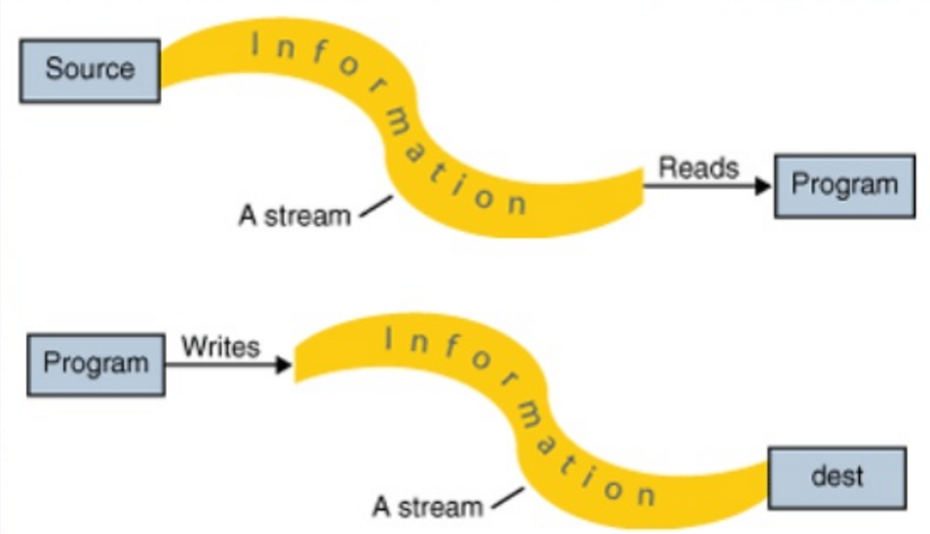
Streams
Stream is a channel through which data can be read or written
InputStream is a channel through which data can be read
OutputStream is a channel through which data can be written

Slide 7
Streams
File (java.io.File) is a class to manage Files on the File system
File f = new File(“/Users/dosapats/a.txt”);
f is a reference to a File named a.txt
File parent = new File(“a”);
File child = new File(parent,”b.txt”);
In the above code, child refers to a file named b.txt in a directory
File f = new File(“/Users/dosapats”);f.listFiles() will list all the files in the directory
All file related methods can be found in java.io.File class

